Slide 1
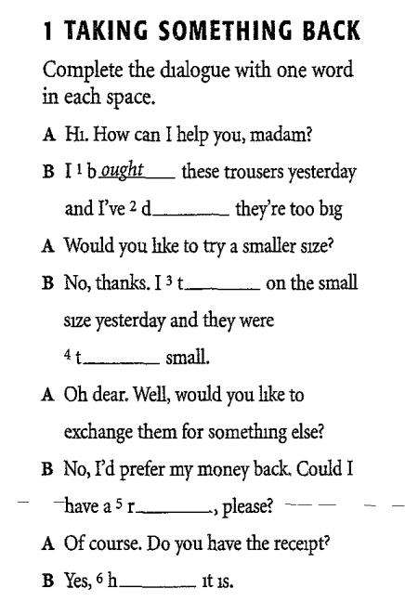
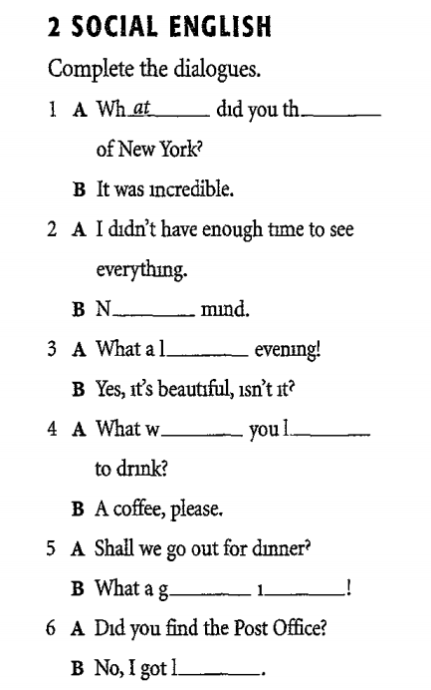

Slide 2
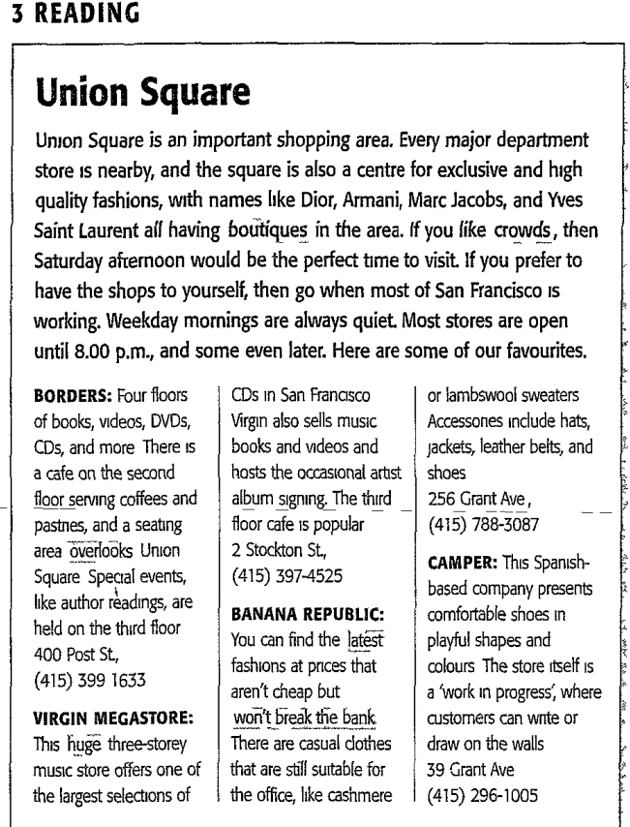
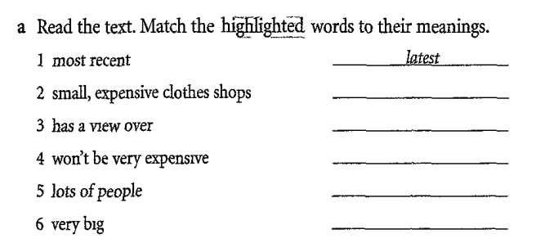

Slide 3
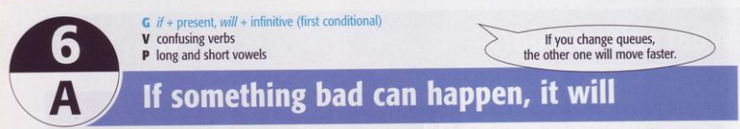
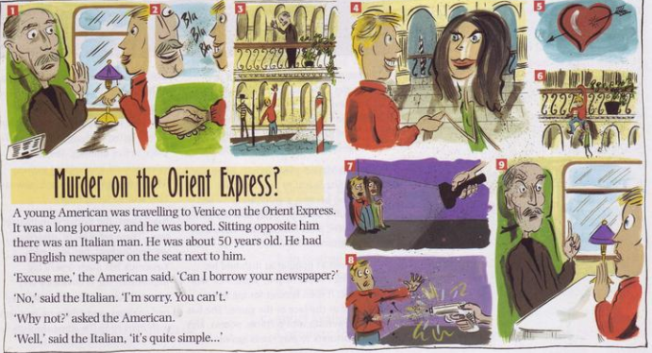
1. Grammar: if + present, will + infinitive
a. Read the beginning of the story. Why do you think the Italian doesn’t want to lend his newspaper to the American?
Ex: The Italian doesn’t want to lend his newspaper to the American because he thinks the American isn’t a good man/he wants to read it /he doesn’t like lending things…

Slide 4
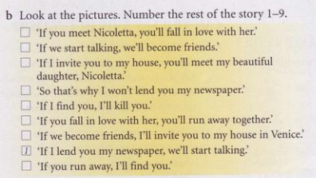

5
2
4
9
8
6
3
7
- What tense is the verb after if?
The present simple
- What tense is other verb?
The future (will/won’t + infinitive)

Slide 5
The first conditional
(Real conditional sentences at present)
a.Form:
If + S + Vs/es (PS), S + will/can/shall… + V-(inf)
b.Uses:
Conditional type 1 is used to guess something that may happen in present or in the future.
Ex: If I get up early in the morning, I will go to school on time.

Slide 6
The first conditional is used to make an offer or suggestion.
Ex: If you need a ticket, I can get you one.
If you don’t have money, I may lend you some.
The first conditional sentence is used for the warning or threatening.
Ex: If you come in, he will kill you.

Slide 7
NOTES:
The if clause can come first or second.
Ex: I’ll come if you like. OR If you like, I’ll come
You have to use the “the comma” when the If clause comes first but the main clause comes first, you don’t need to use it.

Slide 8
In the question the main clause usually comes first.
Ex: What will you do if you have a lot of money?
or: Can you buy me some food if you go to the department store?
To make an offer or suggestion, you can use “can, may, shall” instead of will in the main clause.
Ex: If you need a ticket, I can get you one.
You can also use the imperative or can.
Ex: If you miss the bus, get a taxi
If you miss the bus, you can get a taxi

Slide 9
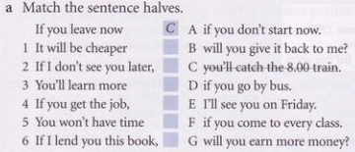
Exercises
D
E
F
G
A
B

Slide 10
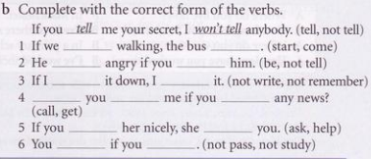
start
will come
will be
don’t tell
don’t write
won’t remember
Will
call
get
ask
will help
won’t pass
don’t study

Slide 11
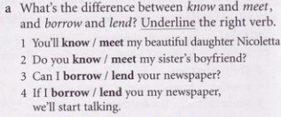
The differences between the confusing verbs.
Meet: To be introduced to sb (= you will see and speak to her for the first time)
Know: To be familiar with sb (= you have met and spoken to him before)
Borrow: To take aloan (= you give me your newspaper)
Lend: To give a loan (= I give you my newspaper)

Slide 12
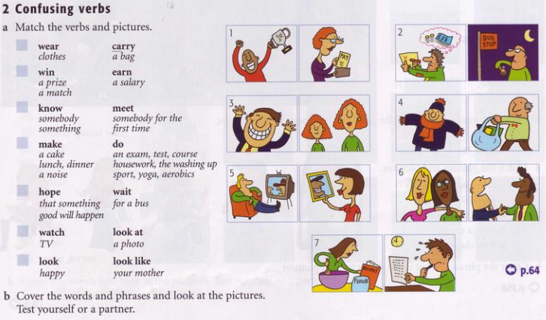
4
1
6
7
2
5
3

Slide 13
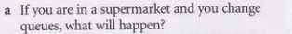
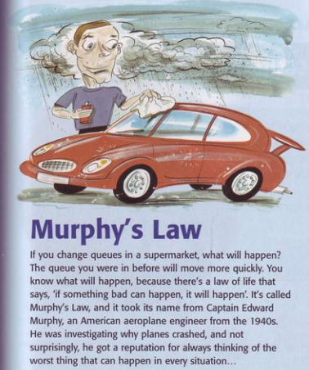
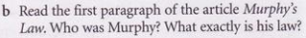
Ex: If I change queues in a supermarket, some else will take my turn.
The answer:
- Murphy was an American aeroplane engineer.
- His law is “If something bad can happen, it will happen”

Slide 14
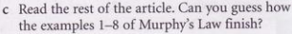
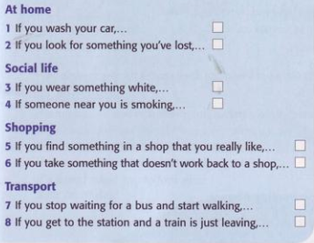
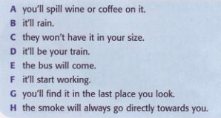
B
G
A
H
C
F
E
D
Ex: If you wash your car, it will rain.

Slide 15
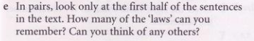
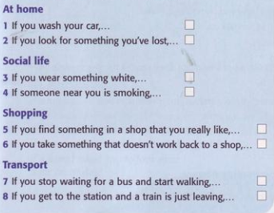
It’ll rain

Slide 16
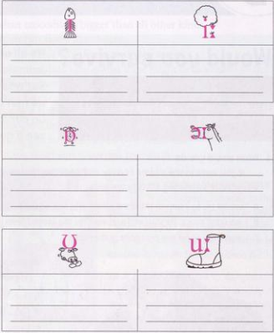
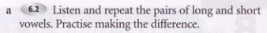
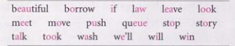
If
leave
will
meet
win
We’ll
borrow
law
stop
story
wash
talk
look
beautiful
push
move
took
queue

Slide 17
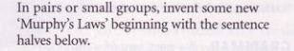
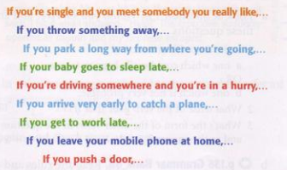

Slide 18
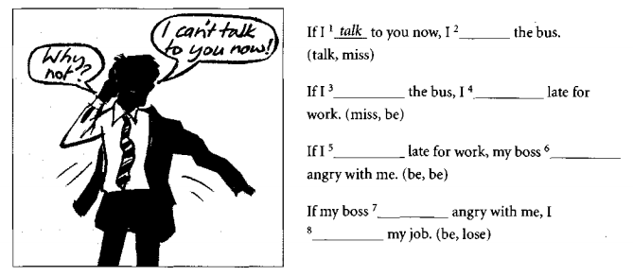
Exercises
‘ll miss
miss
‘ll be
‘m
will be
is
‘ll lose

Slide 19
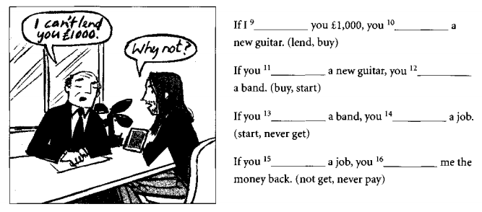
lend
‘ll buy
buy
‘ll start
start
‘ll never
get
don’t get
‘ll never
buy

Slide 20
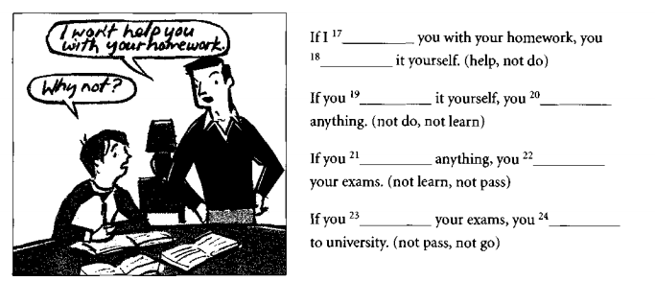
help
won’t do
don’t do
won’t learn
don’t learn
won’t pass
don’t pass
won’t go

Slide 21
Complete the sentences using the correct form of verb from the brackets (1st Conditional)
1. If you________(learn) English, you _____________ (be able to) work in England.
2.They ____________(borrow) a bus if they _________(want) to travel around the world.
3. If she____________(practise) regularly, she _________(play) very well.
4. He_____________(not need) an instrument if he _____(be) a good singer.
5. If I _________(share) it with my friends, I__________(enjoy) the music more.
6. If they_______(come) to their house later, their mum__________(cook) them dinner.
7. If you_____________(not be able to) play volleyball, you__________(arrive) late.
8. Her parents___________(take) her to the beach this summer if she____________(not fail) any tests.
9. If you_____(go) shopping after school, you__________(buy) a magazine.
learn
will be able to
will borrow
want
practises
will play
won’t need
is
share
will enjoy
come
will cook
aren’t able to
will arrive
will take
doesn’t fail
go
will buy

